Slide 1
Water pollution

Slide 2
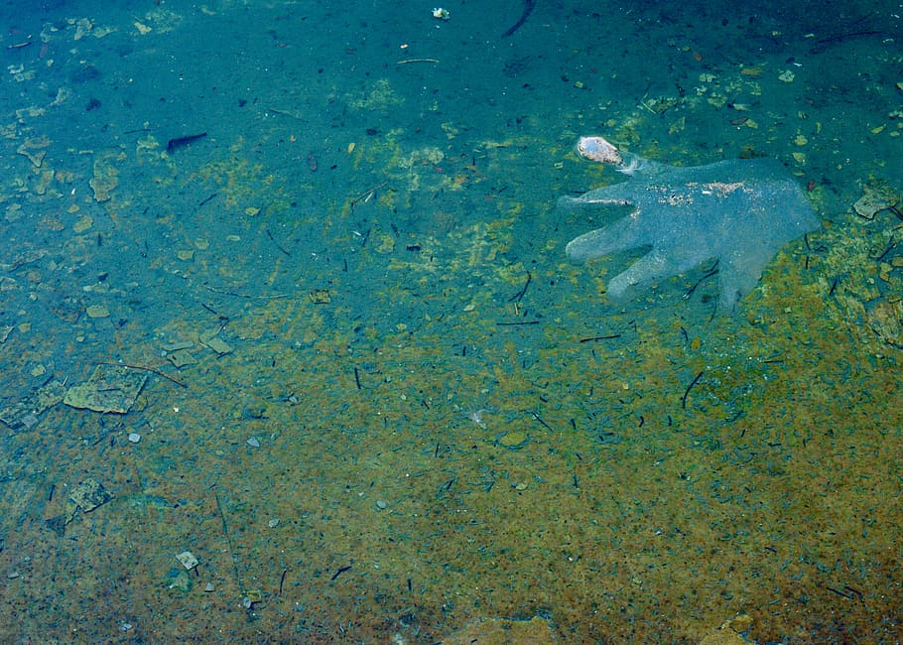

Slide 3
What IS A WATER POLLUUTION ?
Water pollution; the release of substances into sub surface groundwater or into lakes streams rivers estuaries and oceans to the point where to substances interfere with beneficial use of the water or with the natural functioning of ecosystems.

Slide 4
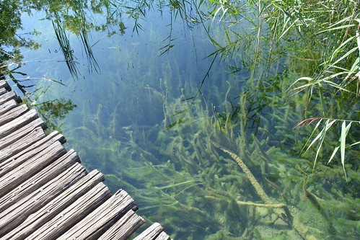

Slide 5
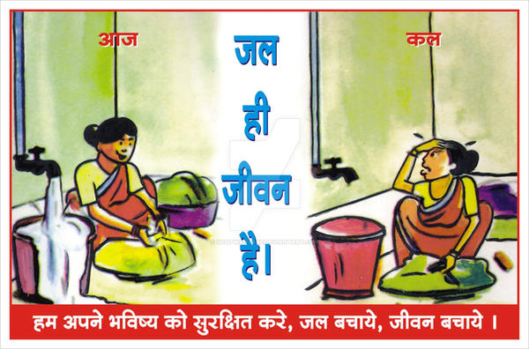

Slide 6
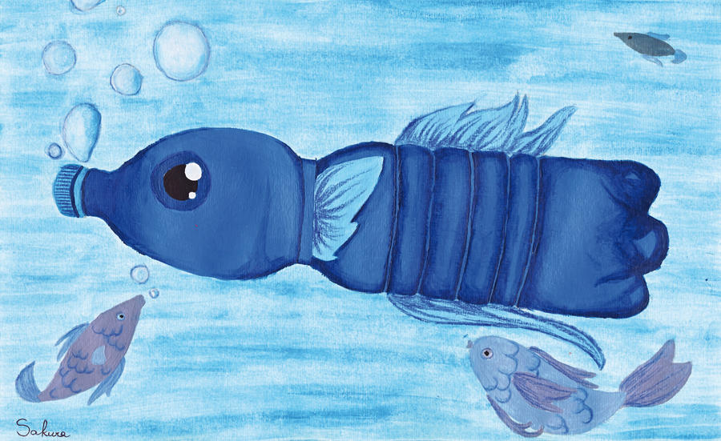
Policy water pollution
policy instrument’s for water pollution control in developing countries.

Slide 7
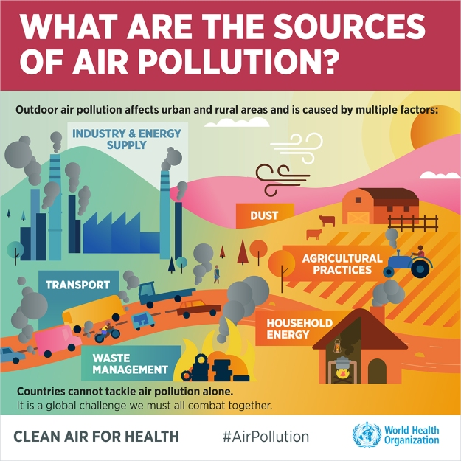

Slide 8


Slide 9
slogans on water pollution
Avoid water pollution or there’ll be water but not a single drop to drink.
Water pollution needs a fast a solution.
Don’t throw trash at the front house .
A day without water is hard so don’t let it become your future.

Slide 10
What is tha difference between air pollution and water pollution ?
Air pollution is defined as tha presence of substances in tha atmosphere that.

Slide 11
Catchy water pollution slogans ?
Think blue
Don’t pollute water s stay healthy
Water ; don’t waste it
Would you drink this
Nom more water pollution
Say no to sipping swage
Stop water pollution

Slide 12
QUARY ?

Slide 13
THANK YOU

